Slide 1

Complex Computing problem
AUTOMATED TELLER MACHINE
Group Members:
Hassaan (CT-25097)
Samar (CT-25086)
Haider (CT-25085)

Slide 2
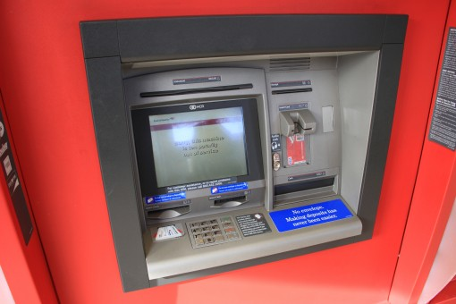
brief INTRODUCTION
 | Our project is an Automated Teller Machine (ATM) which is used daily by many people to perform money related transactions. We chose this particular topic because it tests wide range of skills of the programmers as it uses: arrays, different library functions and also involves complex logic to make it work together.

Slide 3
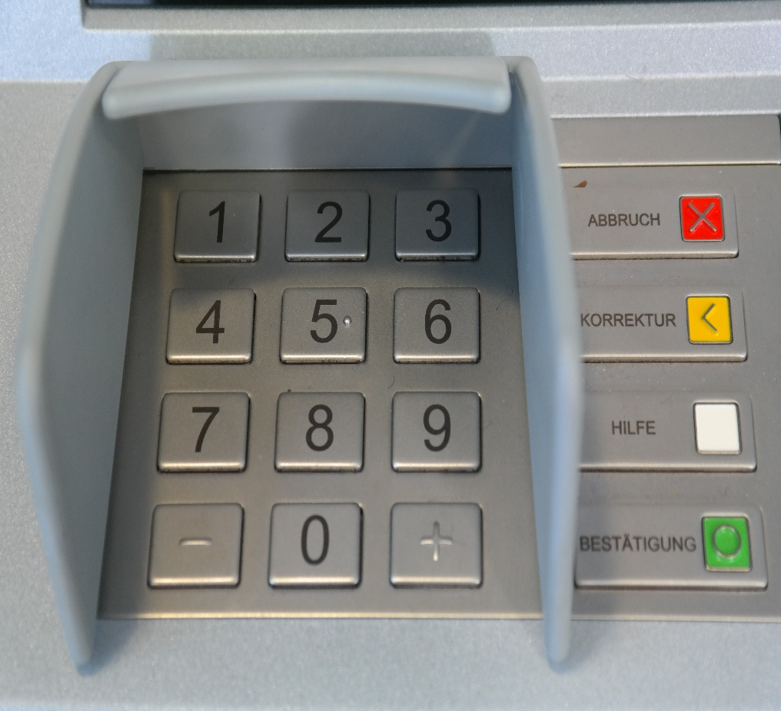
Salient Features of the ATM:
User Authentication:
1.Users will log in using their Account ID and PIN.
2.After three failed attempts, the system will lock the account.
Account Management:
1.Users can check their balance.
2.Users can view transaction history (deposits and withdrawals).
Withdrawal and Deposit:
1.Users can withdraw funds from their account if the balance is sufficient.
2.Users can deposit money into their account, updating the balance immediately.
Transaction Logging:
1. Every transaction (deposit or withdrawal) will be recorded in a log file using file handling.
Security:
1. PIN authentication ensures that only authorized users can access the system.
Exit and Logoff:
1. Users will be able to log out after completing their transactions.

Slide 4

TECHNICAL REQUIRNMENTs
Language: C
Platform: Windows/Linux/Mac OS (console-based)
File Handling: For storing transaction logs.
Header File: stdio.h for standard input and output operations and other library functions for different purposes.

Slide 5
NOW OVER TO EXPLANATION OF THE CODE

Slide 6
Headers and macros
#include <stdio.h>
#include <stdlib.h>
#include <string.h>
#define FILE_NAME "text.txt"
#define MAX_ACCOUNTS 10
• stdio.h — input/output (printf, scanf, FILE I/O).
• stdlib.h — general utilities (not strictly needed in your code as written, but often included for exit, malloc, etc.).
• string.h — string operations (not used heavily here but commonly included).
• FILE_NAME — filename used for reading/writing account data.
• MAX_ACCOUNTS — maximum accounts the program will load/store (array sizing and safety).

Slide 7
Data structures
typedef struct {
int pin;
char name[50];
float balance;
} Account;
typedef struct {
Account accounts[MAX_ACCOUNTS];
int count;
} AccountList;
Account stores a single account: integer pin, name (up to 49 chars + null), and balance.
AccountList is a container for up to MAX_ACCOUNTS accounts and tracks how many are currently loaded (count).

Slide 8
load_all_account_data()
int load_all_account_data(AccountList *list) {
FILE *file = fopen(FILE_NAME, "r");
if (file == NULL) {
printf("Account file not found (%s). Please create a 'text.txt' file with account data.\n", FILE_NAME);
return 0;
}list->count = 0;
while (list->count < MAX_ACCOUNTS) {
int result = fscanf(file, "%d,%49[^,],%f\n",
&list->accounts[list->count].pin,
list->accounts[list->count].name,
&list->accounts[list->count].balance
);if (result == 3) {
list->count++;
} else if (result == EOF) {
break;
} else {
printf("Error reading account data near line %d. Please check the format.\n", list->count + 1);
fclose(file);
return 0; } } fclose(file);
printf("Successfully loaded %d account(s).\n", list->count);
return 1;}
·Opens text.txt for reading. If missing, prints an error and returns failure (0).
·Initializes list->count to 0.
·Repeatedly uses fscanf to parse lines of the form: PIN,Name,Balance (comma-separated). Format explanation:
%d reads integer PIN.
%49[^,] reads up to 49 chars for Name stopping at the next comma (prevents overflow).
%f reads the float Balance.
The \n in format helps absorb the newline but is not strictly required; fscanf ignores whitespace for numeric conversions.
·If fscanf reads 3 items, it increments count.
·If fscanf returns EOF, we reached end of file and stop.
·If any parsing error occurs (unexpected format), the function prints an error and returns failure.
·On success, it closes the file and returns 1.

Slide 9
save_all_account_data()
void save_all_account_data(const AccountList *list) {
FILE *file = fopen(FILE_NAME, "w");
if (file == NULL) {
printf("Critical Error: Cannot save account data.\n");
return;
}
for (int i = 0; i < list->count; i++) {
fprintf(file, "%d,%s,%.2f\n",
list->accounts[i].pin,
list->accounts[i].name,
list->accounts[i].balance
);
}
fclose(file);
Opens text.txt for writing (mode "w"). This overwrites the entire file with current account data.
Iterates all loaded accounts and writes each as PIN,Name,Balance with balance formatted to two decimals.
Closes the file.
Note: Because it overwrites the whole file, any earlier data not present in list will be lost — but this is correct if AccountList is the single source of truth.

Slide 10
5. atm_machine() 5.1 Setup and loading accounts:
AccountList account_list;
int entered_pin;
int logged_in_index = -1;
if (!load_all_account_data(&account_list)) {
return;
}
Declares AccountList and other local variables.
Loads accounts from disk. If loading fails, function returns early.

Slide 11
5. atm_machine() 5.2 Authentication
printf("\n--- sharcodec ATM Login ---\n");
printf("Enter your PIN: ");
while (getchar() != '\n');
if (scanf("%d", &entered_pin) != 1) {
printf("Invalid PIN format. Exiting...\n");
while (getchar() != '\n');
return;
}
for (int i = 0; i < account_list.count; i++) {
if (entered_pin == account_list.accounts[i].pin) {
logged_in_index = i;
break;
}
}
if (logged_in_index == -1) {
printf("Incorrect PIN or account not found. Exiting...\n");
return;
}
Account *active_account = &account_list.accounts[logged_in_index];
printf("\nAccess Granted. Welcome %s!\n", active_account->name);
• Prompts user for PIN.
• There is a while (getchar() != '\n'); line intended to clear the input buffer. (If the buffer is already empty this will wait for a newline; in typical usage after earlier input it might be OK, but it’s a small fragility — see “gotchas” below.)
• Reads PIN via scanf("%d", &entered_pin). If input isn’t an integer, prints error and exits.
• Searches loaded accounts for a matching pin. If found, sets logged_in_index.
• If no match, prints error and exits.
• If found, creates an Account *active_account reference and welcomes user by name.

Slide 12
5. atm_machine() 5.3 ATM menu loop:
int choice;
float amount;
while (1) {
printf("\n--- Sharcodec ATM Menu for %s ---\n", active_account->name);
printf("1. Withdraw\n2. Deposit\n3. Check Balance\n4. Exit\n");
printf("Please choose an option (1-4): ");
if (scanf("%d", &choice) != 1) {
printf("Invalid input. Please enter a number.\n");
while (getchar() != '\n');
continue;
}
if (choice == 1) { // Withdraw
save_all_account_data(&account_list);
} else if (choice == 2) { // Deposit
save_all_account_data(&account_list);
} else if (choice == 3) { // Check Balance
printf("Your current balance is: $%.2f\n", active_account->balance);
} else if (choice == 4) { // Exit
printf("Thank you, %s. Goodbye!\n", active_account->name);
break;
} else {
printf("Invalid option. Please try again.\n");
}
}
Displays menu and reads user option.
• If scanf for the option fails, it clears input and repeats the menu.
• For Withdraw:
• Reads amount (float). Validates amount > 0.
• Checks sufficient balance. If OK, subtracts amount from active_account->balance, prints success, and calls save_all_account_data() to persist change.
• For Deposit:
• Reads amount, validates > 0, adds to balance, prints success, and saves file.
• For Check Balance:
• Prints current balance (from active_account).
• Option 4 breaks the loop and exits ATM.
• Menu loop repeats until user chooses Exit.

Slide 13
Main Function
int main() {
atm_machine();
return 0;
}
Simple entry point: calls the ATM function and returns.

Slide 14
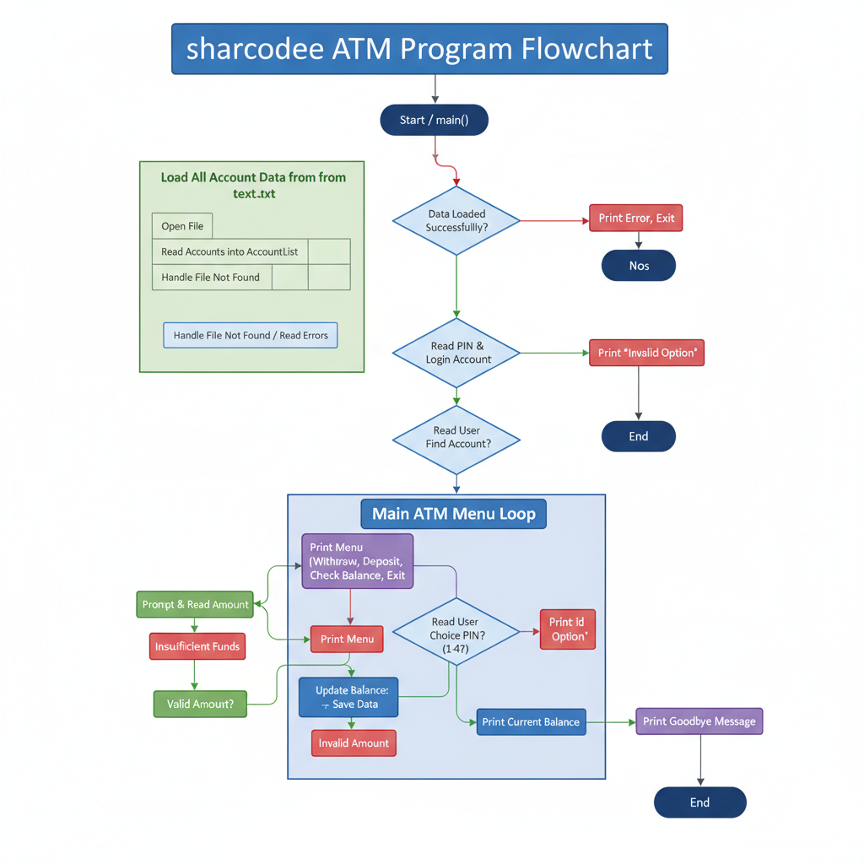
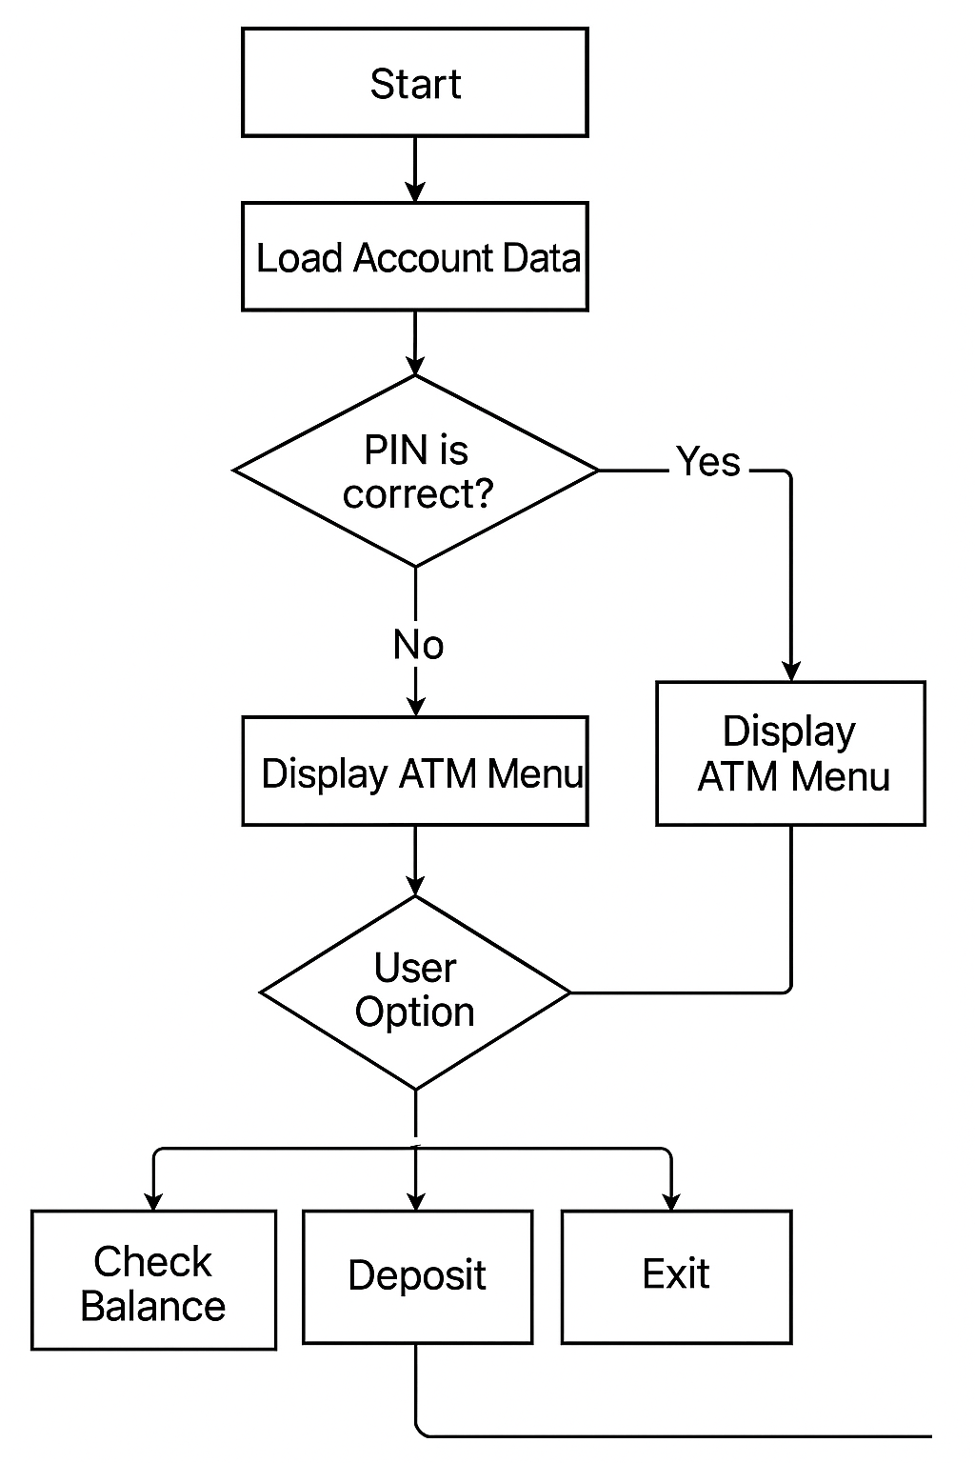
Flowchart for the program

